Slide 1




SE Project
Name: Manjiri Naik
Roll No.: 21102B0008
Class : CMPN-B
TOPIC
PROCESS FRAMEWORK

Slide 2

How is an application created ?
Like most professionals, software engineers follow a system or order of working while developing an application. The system involves collecting relevant data from the customer, writing code, running tests, and catching bugs. It also includes analyzing risks and improving the application.
In all, we can say, designing the application from scratch.
Now, all this requires a kind of skeleton or framework to ensure that a proper, efficient and generalized pathway is followed throughout the process of application development.

Slide 3

What is
Process Framework ?
A process framework establishes the foundation for a complete software development process by identifying a small number of framework activities that are applicable to all software projects, regardless of size or complexity.
Process framework acts as a format which guides how processes should be performed to achieve the desired results.

Slide 4

Process framework generally comprises of the following elements :
01
ACTIVITIES
ACTIONS
02
03
TASKS

Slide 5

APPLICATION DEVELOPMENT HIERARCHY
A framework includes a set of umbrella activities that are applicable across the entire software process.
Framework
Each framework activity is populated by a set of software engineering actions.
Activities
Each action is populated with individual work tasks that accomplish some part of the work implied by the action.
Actions
Tasks
Tasks – focus on a small, specific objective.
Action – set of tasks that produce a major work product.
Activities – group of related tasks and actions for a major objective.

Slide 6






05
Deployment
The following generic process framework is applicable to the vast majority of software projects :
04
Construction
03
Modeling
02
Planning
01
Communication
List a milestone or deadline.

Slide 7


Generic Process Framework
01. Communication
04. Construction
In this activity, heavy communication with customers and other stakeholders, requirement gathering is done.
Construction is the application of set of procedures that are needed to assemble the product , i.e. coding and testing of the product.
02. Planning
05. Deployment
In this activity, we discuss the technical related tasks, work schedule, risks, required resources etc.
In this, a complete or non-complete product or software are represented to the customers to evaluate and give feedback. On the basis of their feedback we modify the products to supply better product.
03. Modeling
In modelling activity, a product’s model is created in order to better understanding and requirements.

Slide 8

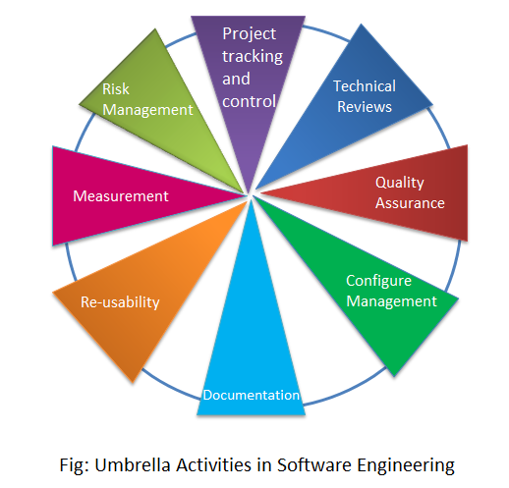
UMBRELLA ACTIVITIES
Umbrella activities are a set of steps or procedures that the software engineering team follows to maintain the progress, quality, change and risks of the overall software development process.
The framework described in the generic view of Software Engineering is complemented by several umbrella activities.

Slide 9
THANK YOU!
Name : Manjiri Naik Roll No. : 21102B0008 Class : CMPN-B

